Slide 1
Data Mining DS-303
Lecture 1
Muhammad Arham
Lecturer
The University of Faisalabad

Slide 2
Content
Supervised Learning
Unsupervised Learning & Clustering

Slide 3
Supervised Learning

Slide 4
What is Supervised Learning?
Supervised Learning is the type of machine learning in which machine are trained using well “Labelled” training data, and on basis of that data, machine predict the output.
In supervised learning the training data provide to the machine work as the supervisor that teaches the machines to predict the output correctly. It applies the same concepts as a students learns in the supervision of the teacher.

Slide 5
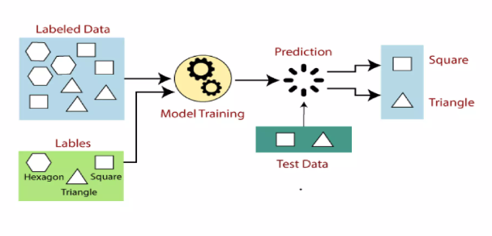
How Supervised Learning Works?

Slide 6



Supervised Learning: Regression
Given (x₁, y₁), (x₂, y₂), ..., (x_{n}, y_{n})
Learn a function f(x) to predict y given x
– y is real-valued == regression
9
8
7
6
5
4
3
2
1
0
1970 1980
September Arctic Sea Ice Extent (1,000,000 sq km)
1990 2000
2010
2020
Year
Data from G. Witt. Journal of Statistics Education, Volume 21, Number 1 (2013)
26

Slide 7










Supervised Learning: Classification
Given (x₁, y₁), (x₂, y₂), ..., (x_{n}, y_{n})
Learn a function f(x) to predict y given x
– y is categorical == classification
Breast Cancer (Malignant / Benign)
1(Malignant)
0(Benign)
Tumor Size
Based on example by Andrew Ng
27

Slide 8







Supervised Learning: Classification
Given (x₁, y₁), (x₂, y₂), ..., (x_{n}, y_{n})
Learn a function f(x) to predict y given x
– y is categorical == classification
Breast Cancer (Malignant / Benign)
1(Malignant)
0(Benign)
Tumor Size
Tumor Size
Based on example by Andrew Ng

Slide 9






Supervised Learning: Classification
Given (x₁, y₁), (x₂, y₂), ..., (x_{n}, y_{n})
Learn a function f(x) to predict y given x
– y is categorical == classification
Breast Cancer (Malignant / Benign)
1(Malignant)
0(Benign)
Tumor Size
Predict Benign Predict Malignant
Tumor Size
Based on example by Andrew Ng

Slide 10
Common Supervised Algorithms
Linear Regression
Logistic Regression
Decision Trees
Support Vector Machines (SVM)
Neural Networks

Slide 11
Advantages & Disadvantages
Advantages
High accuracy with labeled data
Easy to evaluate
Disadvantages
Requires large labeled datasets
Time-consuming data preparation

Slide 12
Unsupervised Learning & Clustering

Slide 13
What is Unsupervised Learning?
Unsupervised learning is a type of machine learning in which models are trained using unlabeled dataset and are allowed to act on that data without any supervision
The goal of unsupervised learning is to find the underlying structure of dataset, group that data according to similarities, and represents that dataset in compressed format.

Slide 14
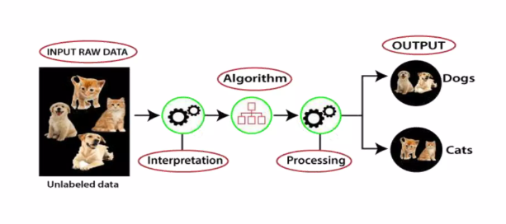
Working of Unsupervised learning

Slide 15
Unsupervised Learning
The most common unsupervised learning method is cluster analysis which is used for exploratory data analysis to find hidden patterns or grouping in data.

Slide 16
Types of Unsupervised Learning
Clustering
Association
Dimensionality Reduction

Slide 17
Advantages & Disadvantages of Unsupervised Learning
Advantages
No labeling needed
Finds hidden patterns
Disadvantages
Harder to evaluate
Less precise results

Slide 18
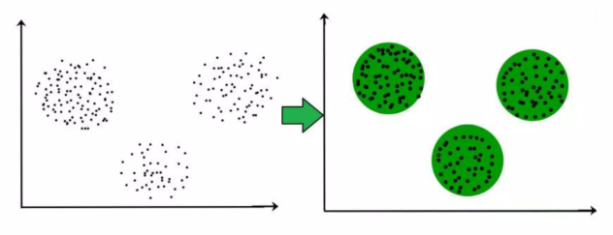
What is Clustering?
A group of object that are similar to other objects in the cluster and dissimilar to data points in other cluster.

Slide 19
Use of clustering
Clustering has been widely used across industries for years:
Biology:- for genetics and species grouping
Medical imaging:- for distinguishing between different kinds of tissues
Markets research:- for differentiating groups of customers based on some attributes
Recommender systems:- giving you better amazon purchase suggestion or Netflix movies matches

Slide 20
Clustering algorithms
Partition- based Clustering
Relatively efficient
E.G. k-means
Hierarchical clustering
Produces trees of clusters
E.G. Agglomerative, Divisive
Density- based clustering
Produces arbitrary shaped clusters
E.G. DBSCAN

Slide 21
Reference
https://www.slideshare.net/slideshow/supervised-machine-learning-258014214/258014214#4
https://www.slideshare.net/slideshow/unsupervised-learning-clustering-238979833/238979833

Slide 22
Advice
Kindly read the book before and after the lecture, if some terms/ words are not covered in the lecture, if appear in exam it might not appear strange or out of course.

